Slide 1
LANDLORD
A mobile game made by Group 01

Slide 2


MEMBERS
Nguyen Van Giap
Hoang Ha

Slide 3


MEMBERS
Ha Anh Tuan
Truong Quoc Tuan

Slide 4
GAME CONCEPTS
The first version of landlord

Slide 5
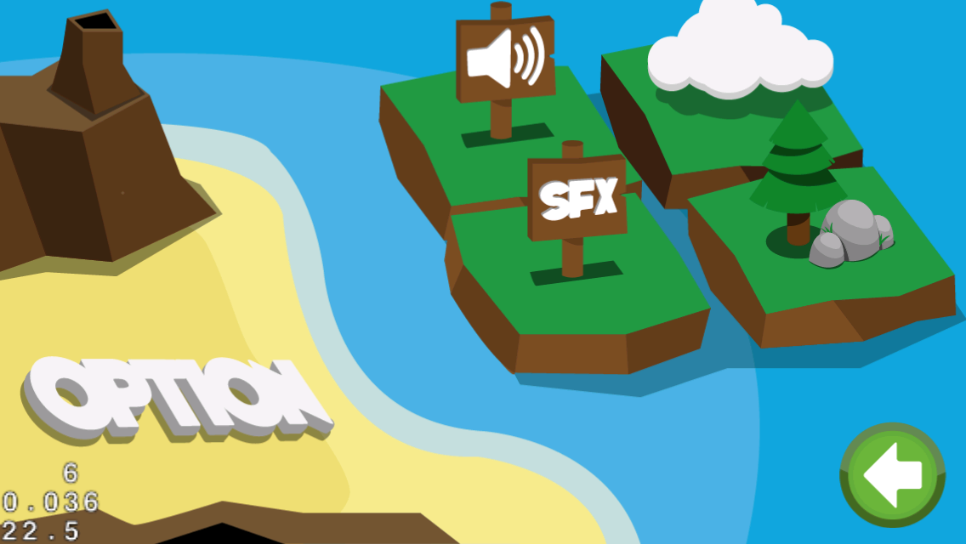
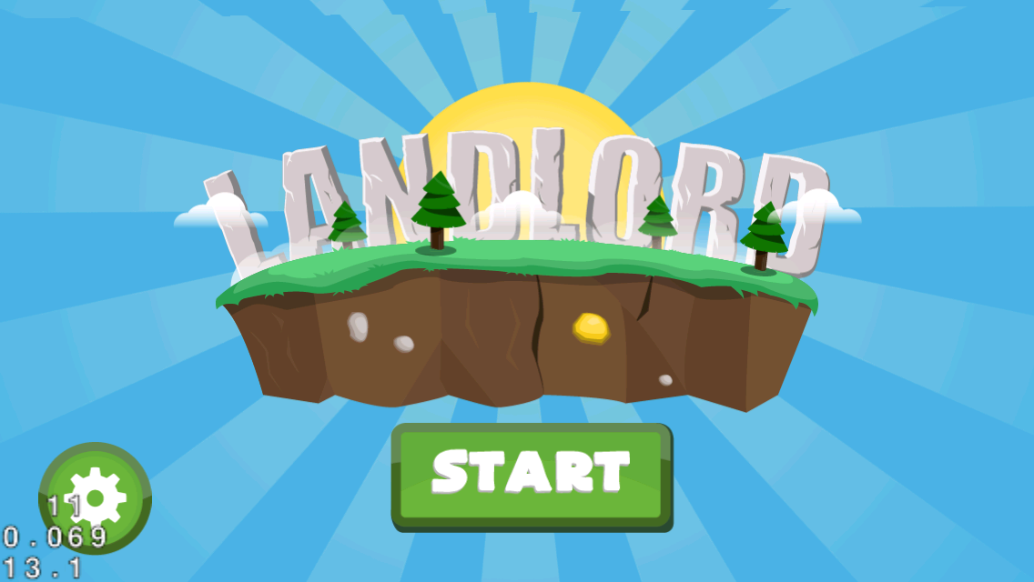

Slide 6
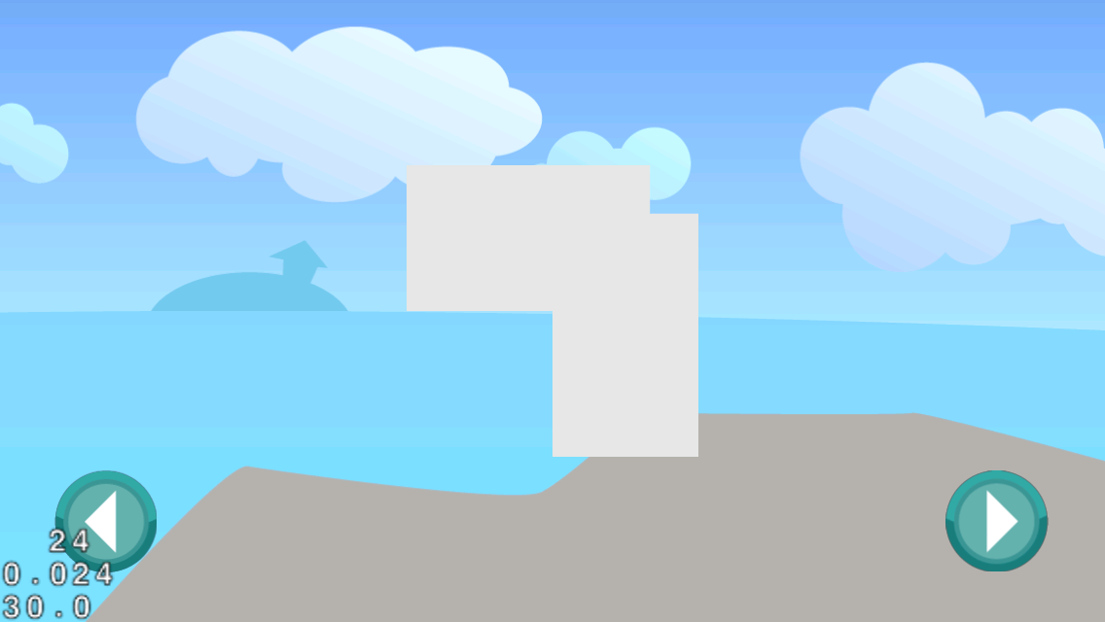


Slide 7
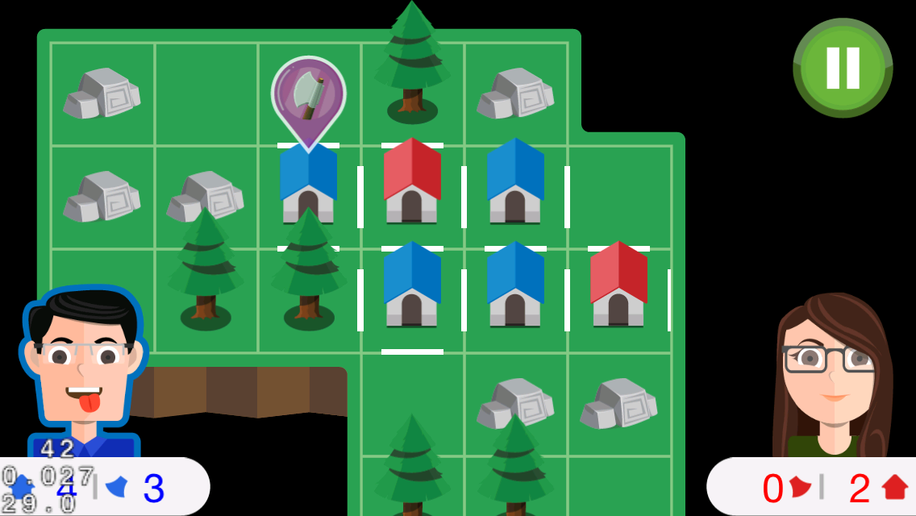
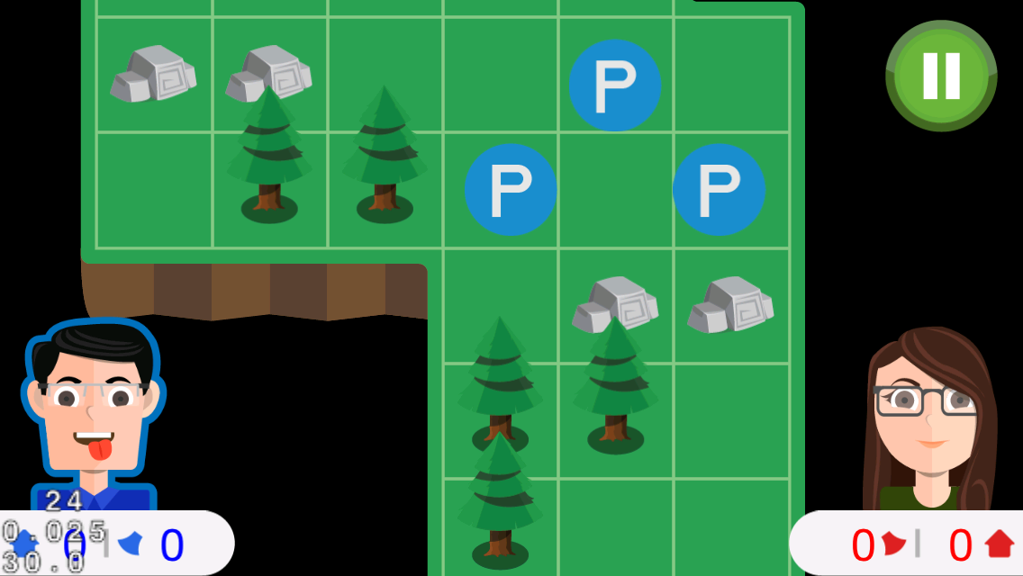

Slide 8
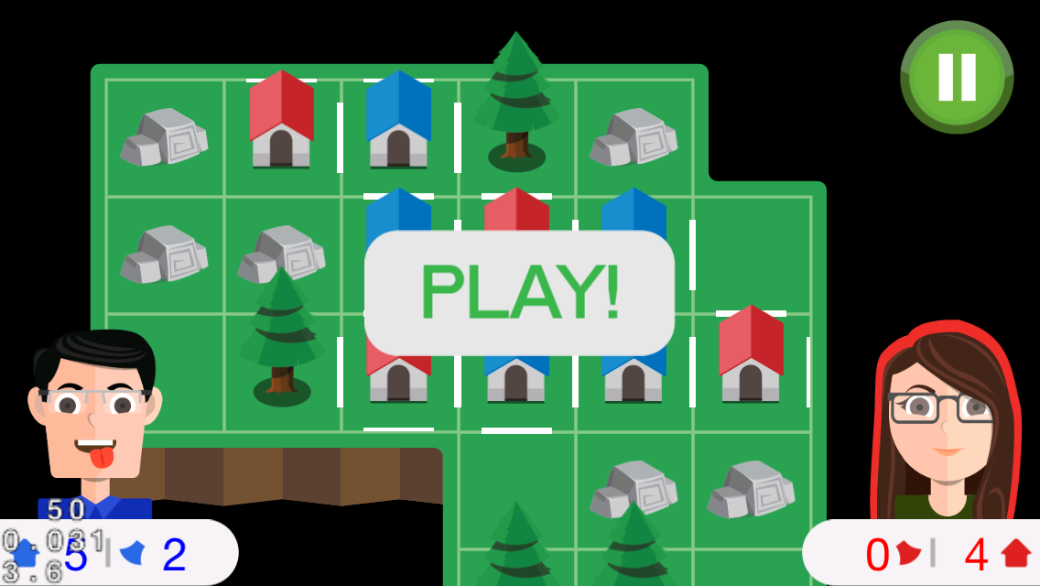


Slide 9
IDEA
inspired by a game on paper
a board game
2-player
FUN and COOL

Slide 10
GAMEPLAY
two players compete with each other
build houses and occupy the islands
tree mode, axes, …
https://github.com/tranvictor/landlord/ wiki

Slide 11
CONTROL
touch on tiles!
choose the edge to put fence
special tiles with hidden axe, tree, stone !
collect axes
use axe to cut trees

Slide 12

COCOS2D-X
An awesome framework for making cross platform mobile games

Slide 13
PROJECT MANAGEMENT
pivotaltracker.com/s/projects/1031608

Slide 14
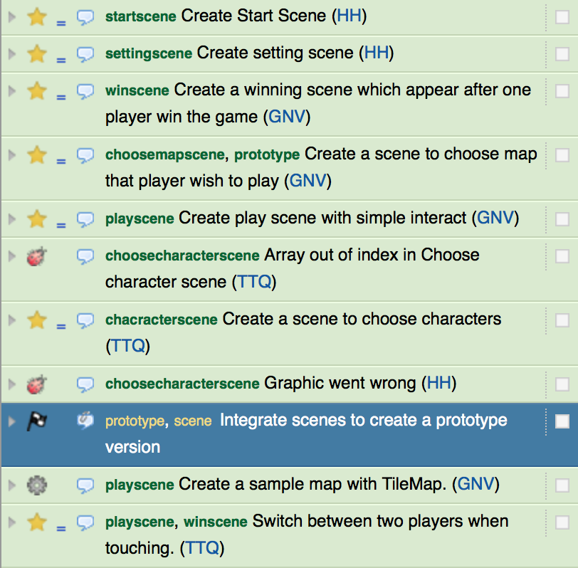
PIVOTALTRACKER

Slide 15
REVISION CONTROL AND SOURCE CODE MANAGEMENT
github.com/tranvictor/landlord

Slide 16
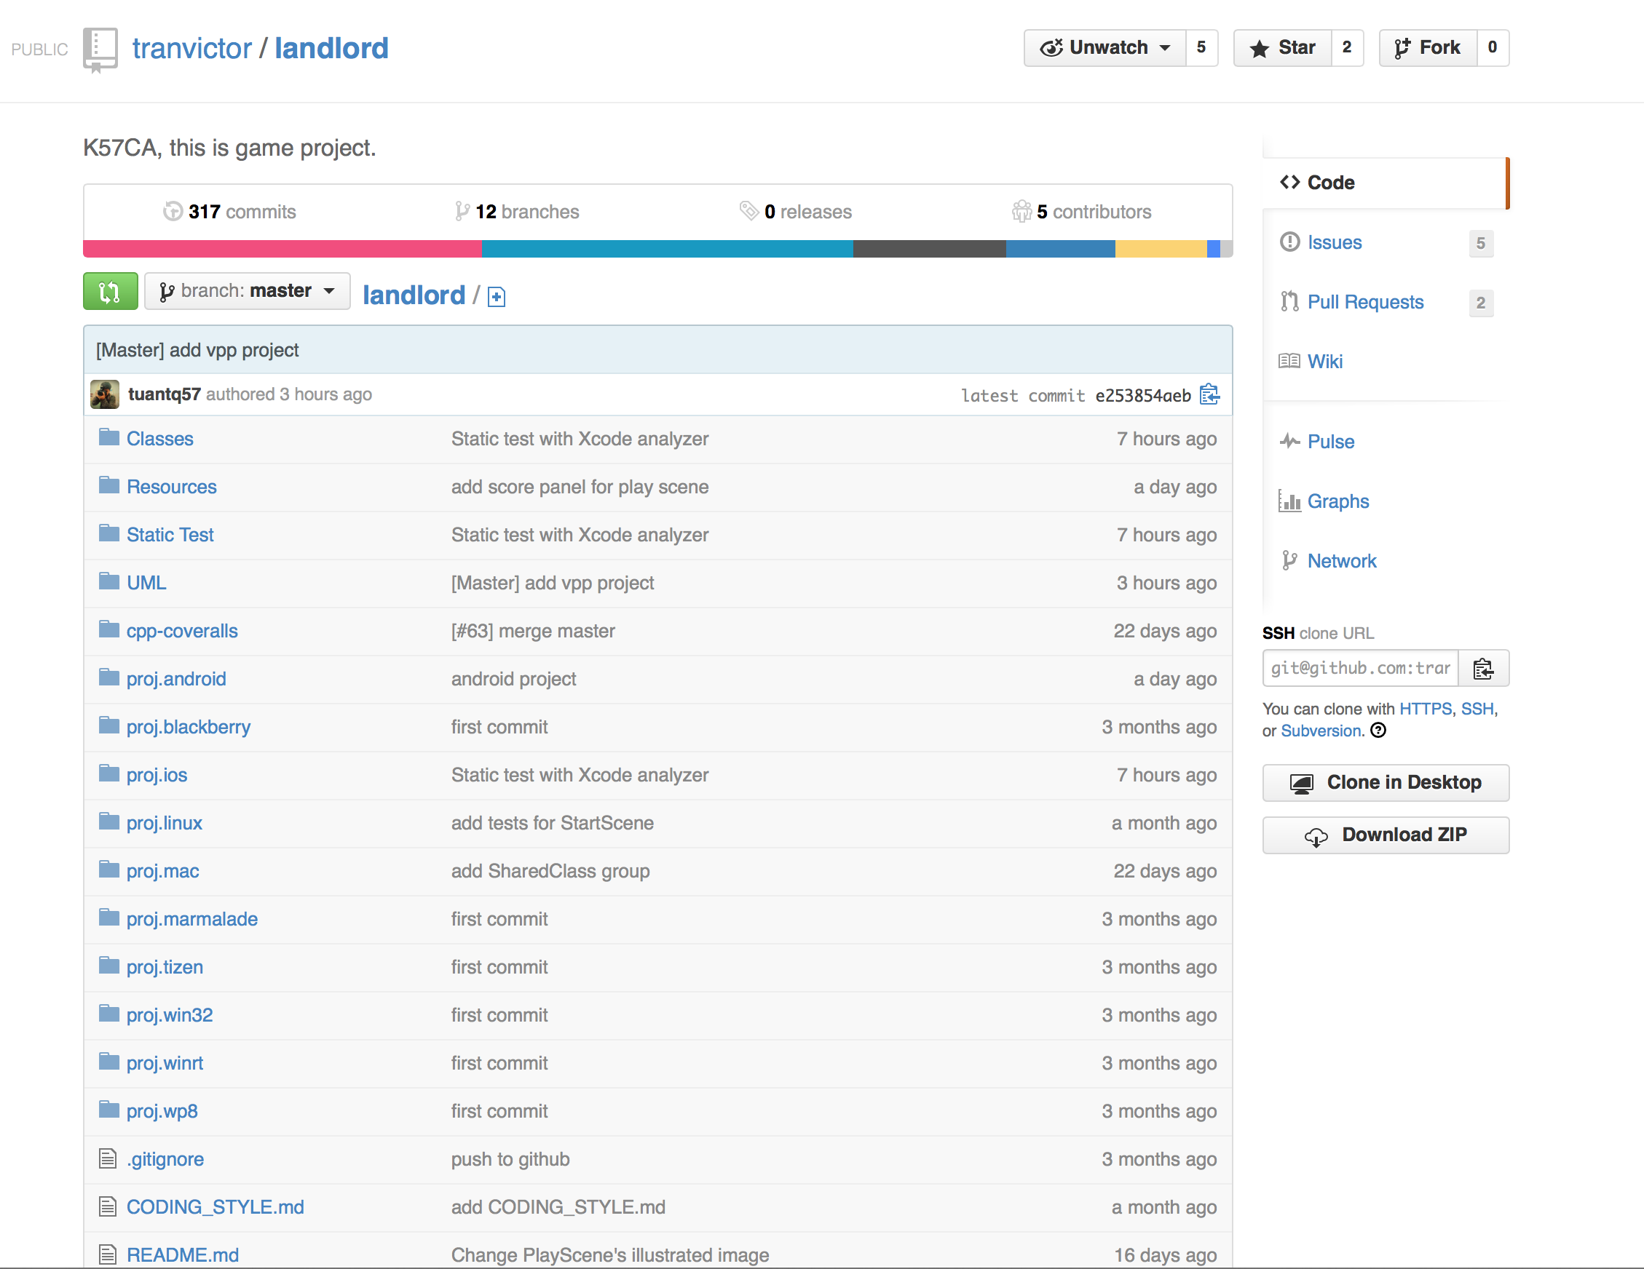
GITHUB REPO

Slide 17
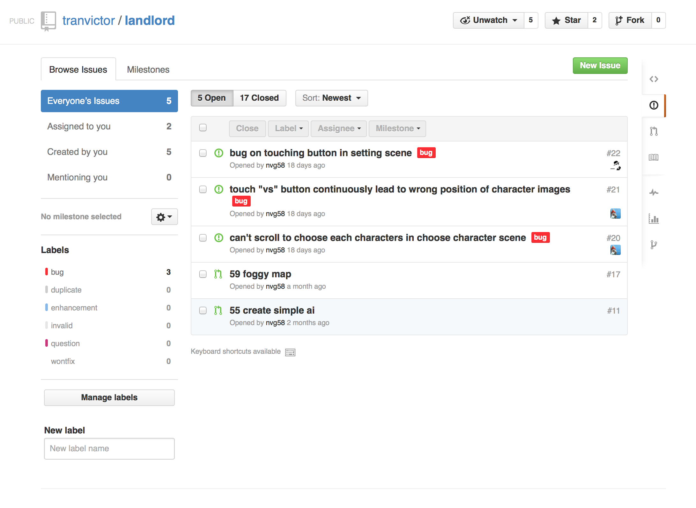
BUG TRACKING

Slide 18
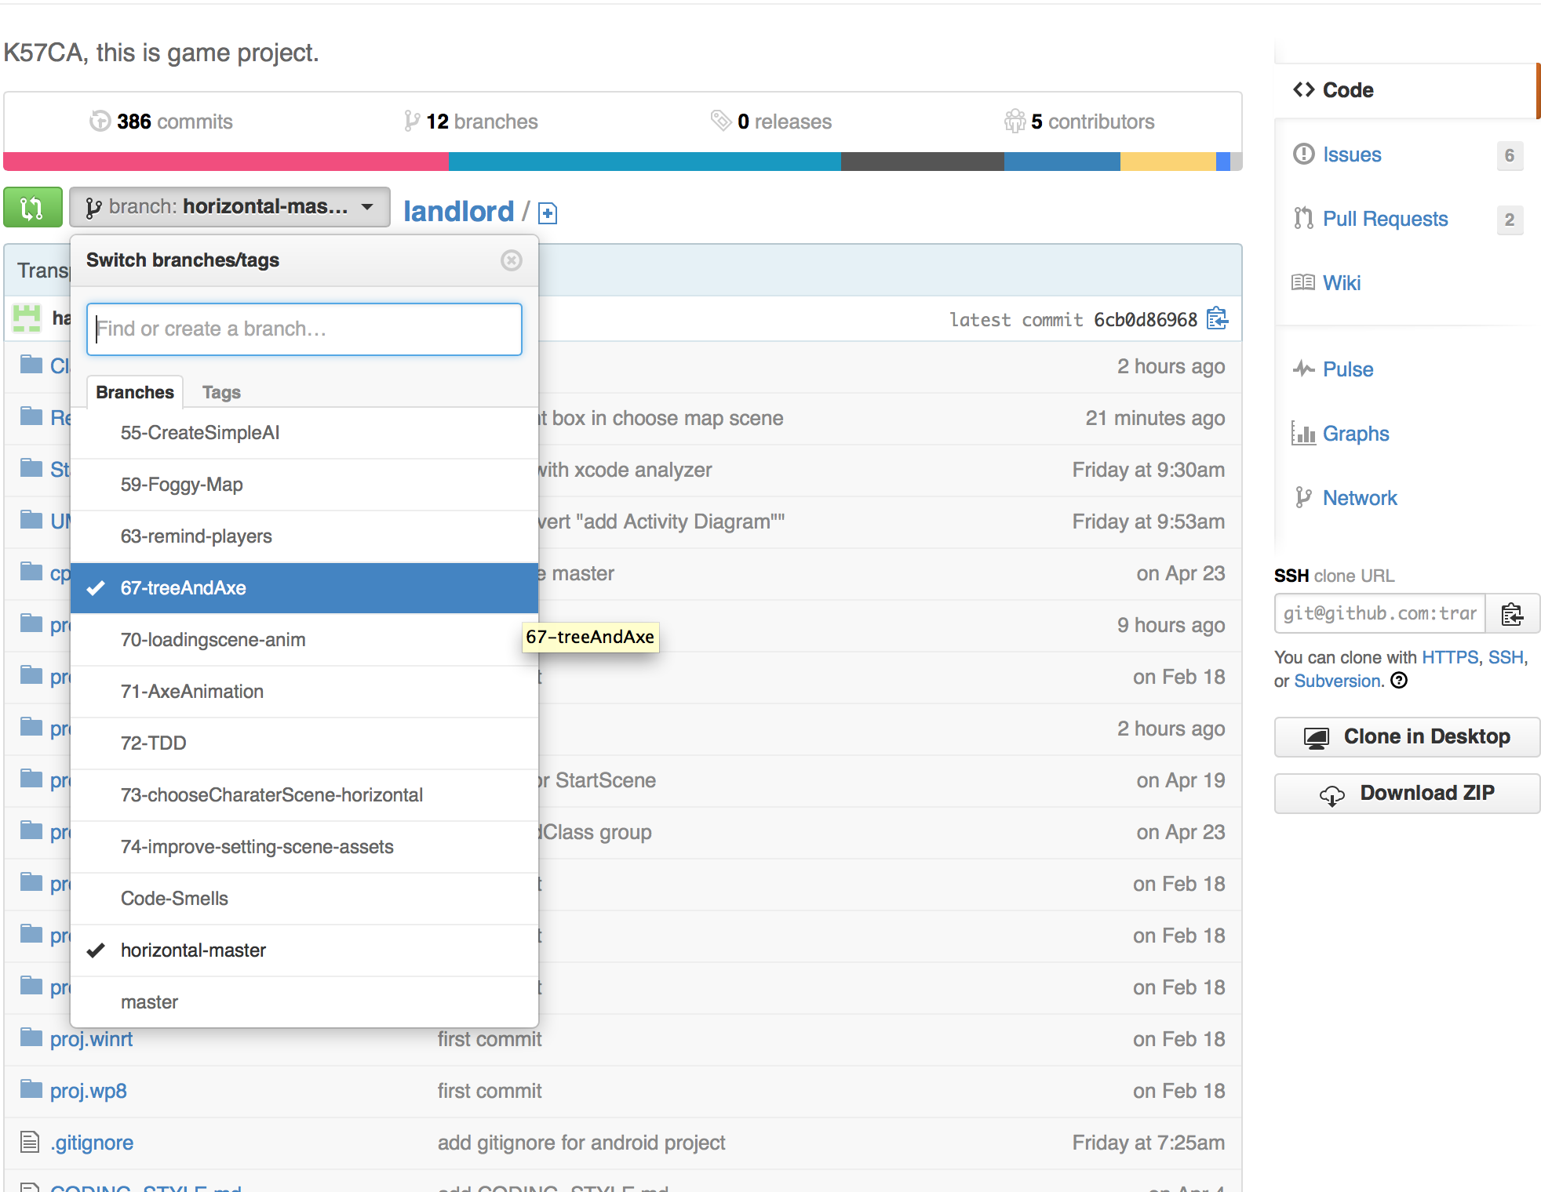
GIT WORKFLOW

Slide 19
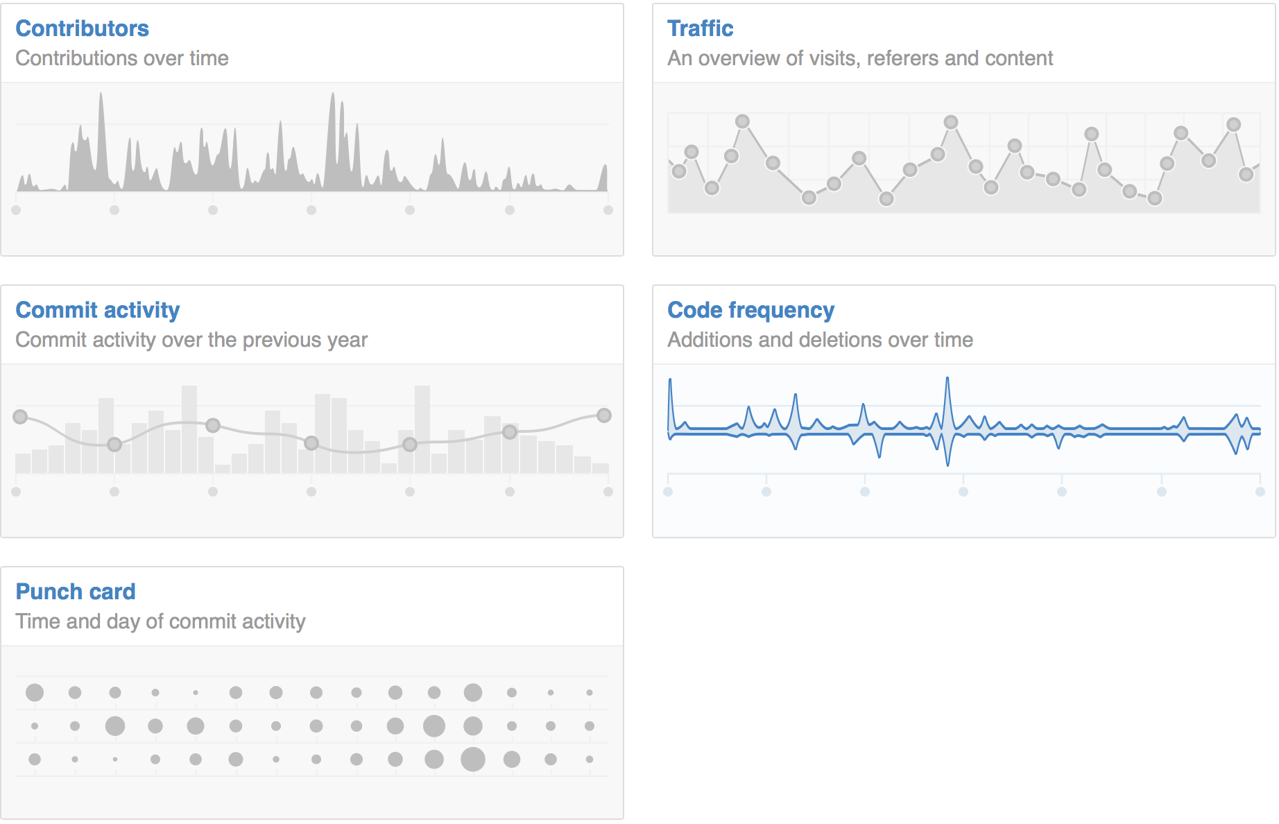
STATISTICS

Slide 20
SOFTWARE DEVELOPMENT PROCESS
Using Test-driven development (TDD)

Slide 21
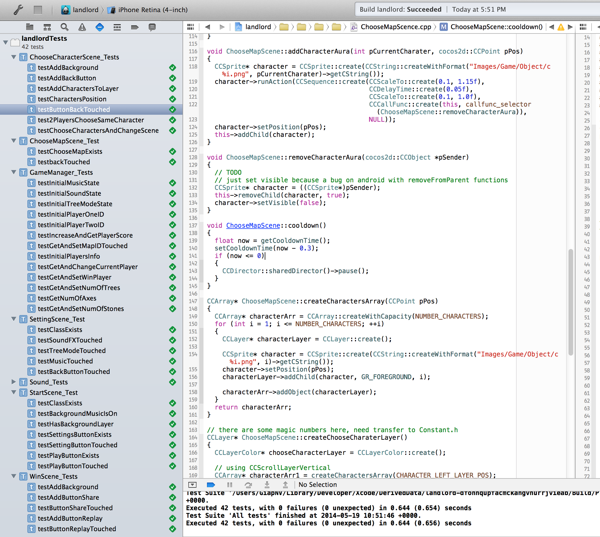
SENTESTINGKIT

Slide 22
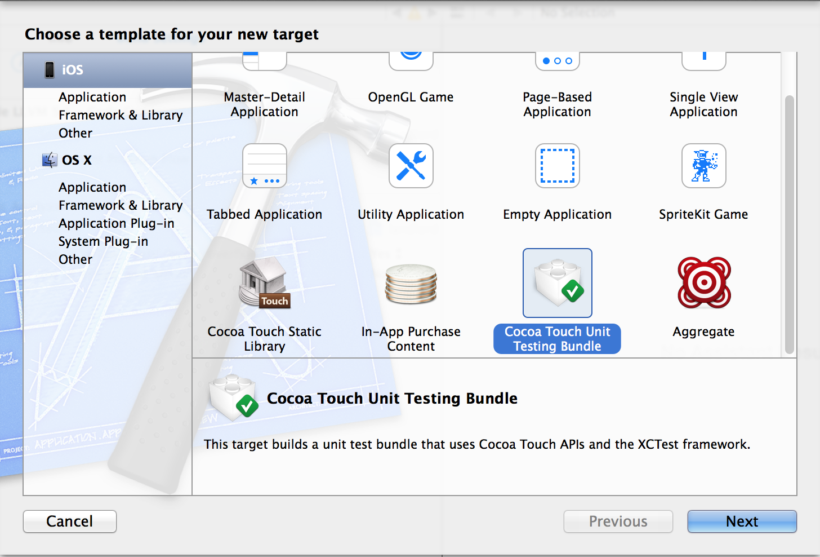
COCOA TOUCH UNIT TESTING

Slide 23
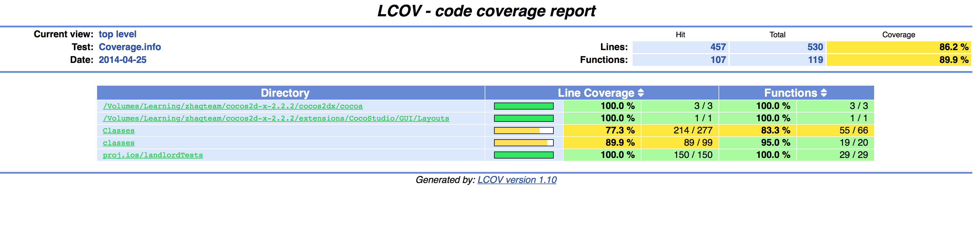
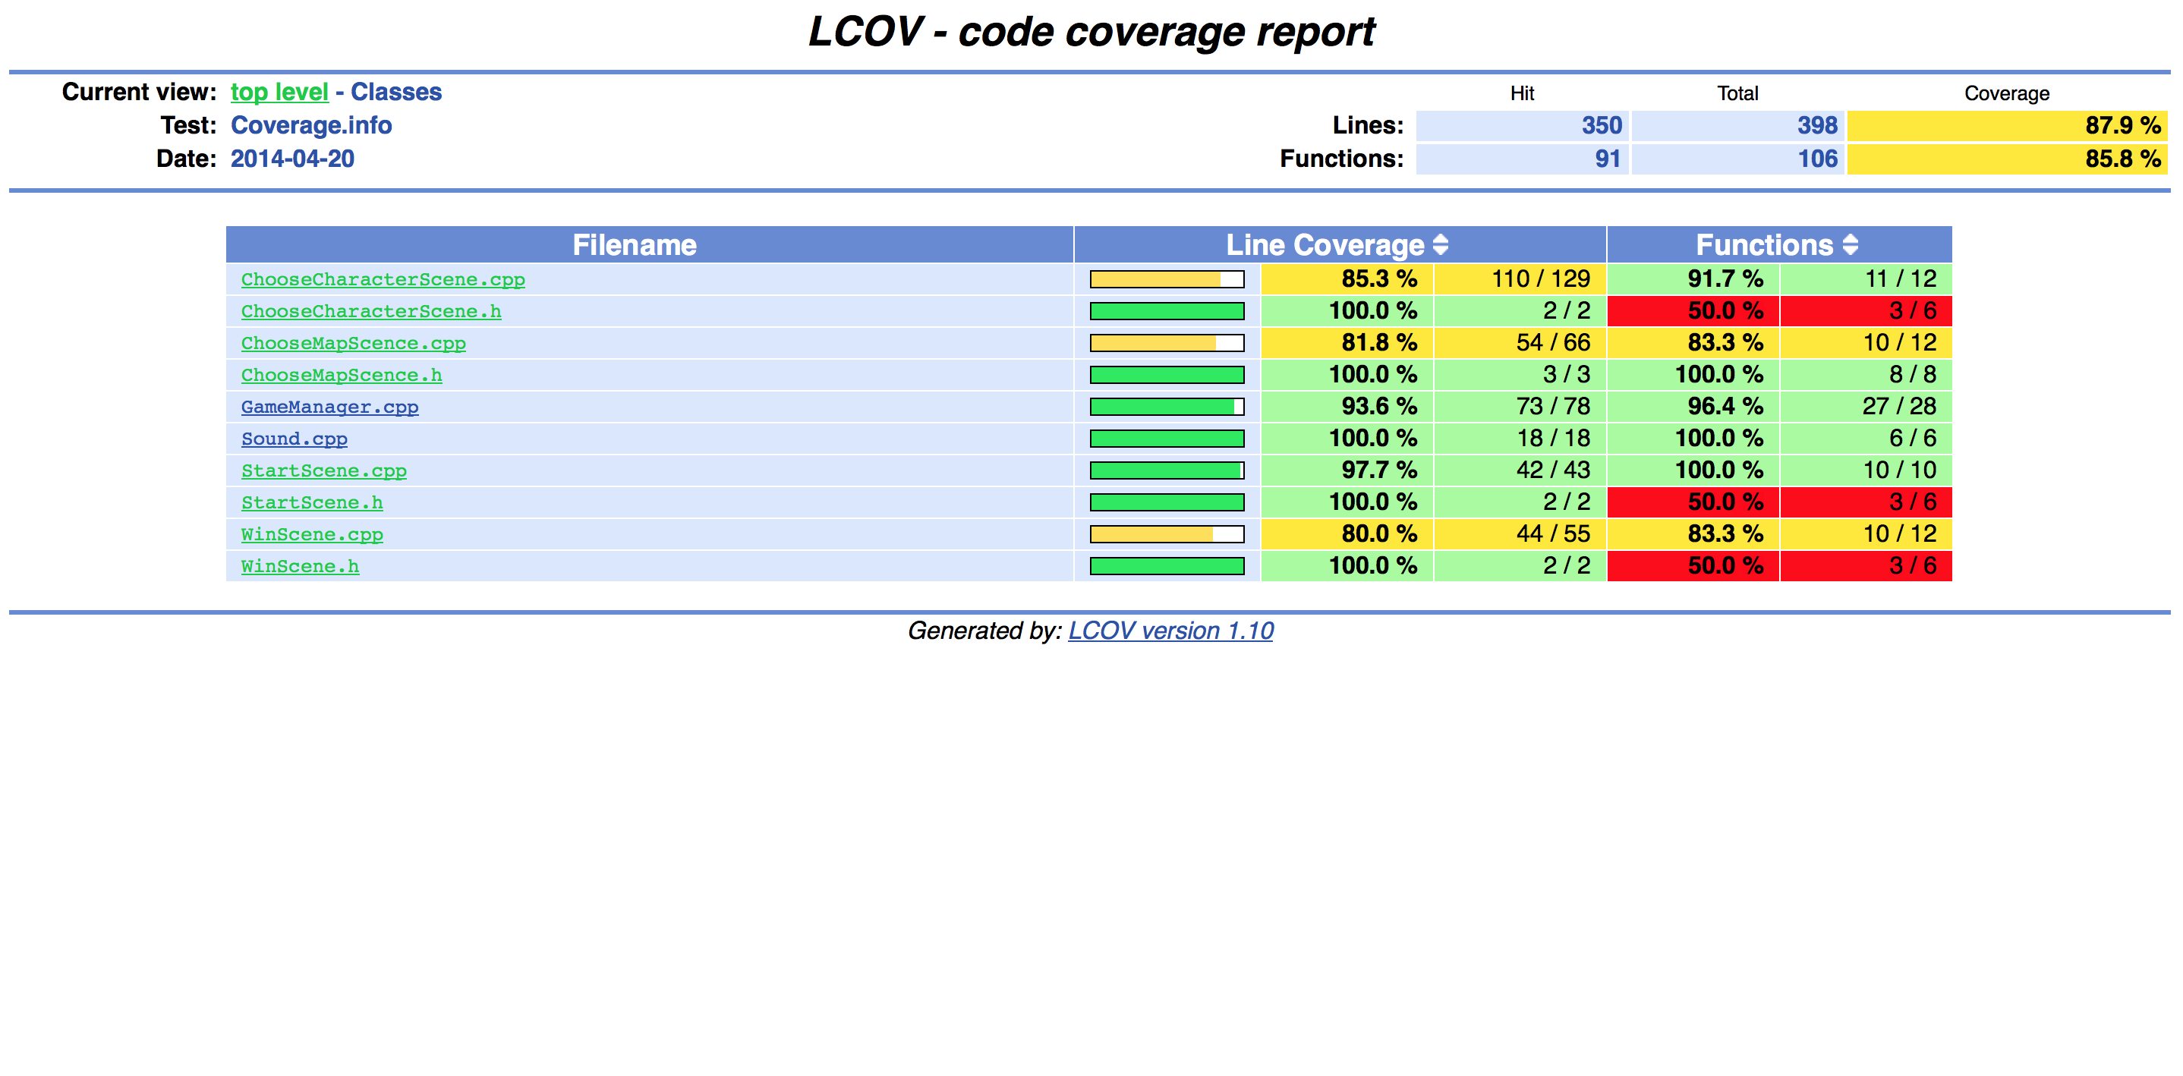
TEST COVERAGE

Slide 24
STATIC SOURCE CODE ANALYSIS
Using LLVM 3.4

Slide 25
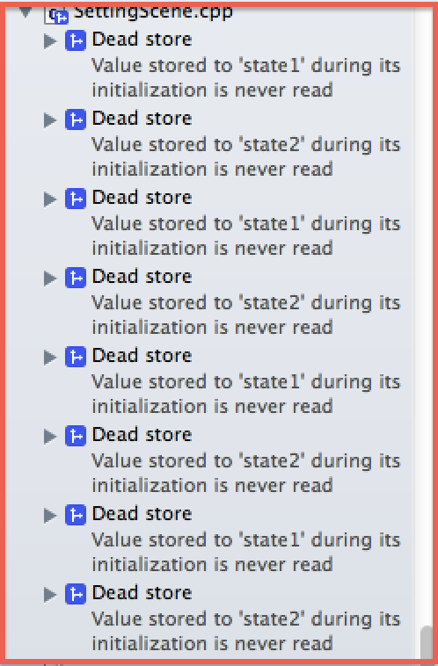
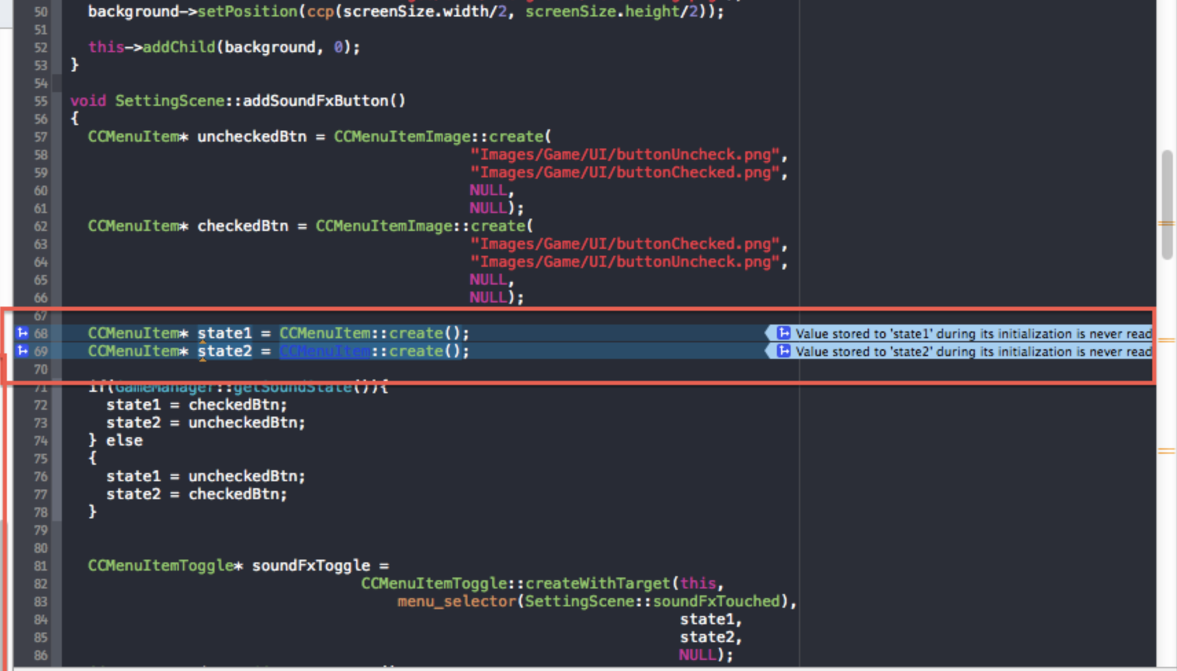
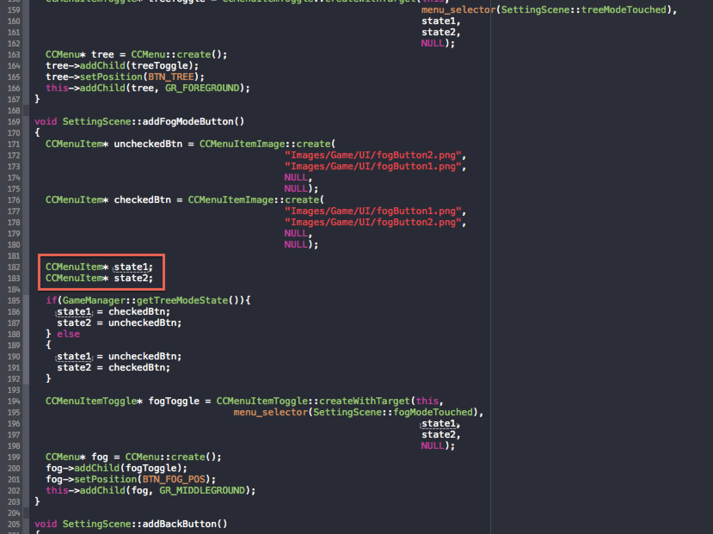
LLVM 3.4

Slide 26
SYSTEM'S ARCHITECTURAL BLUEPRINTS
Unified Modeling Language (UML)

Slide 27
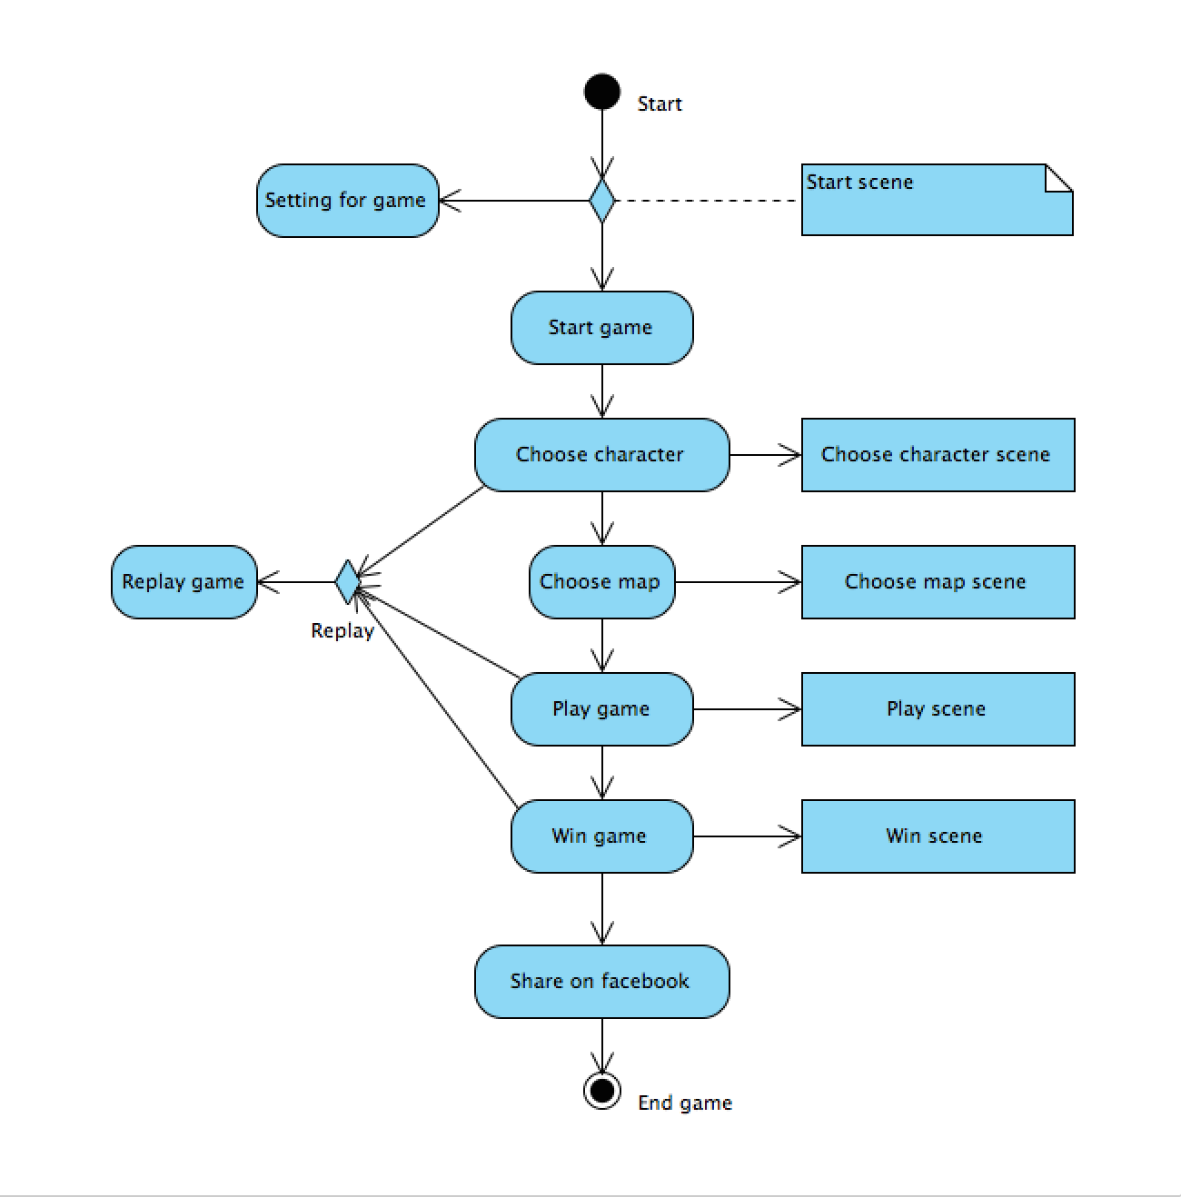
ACTIVITY DIAGRAM

Slide 28
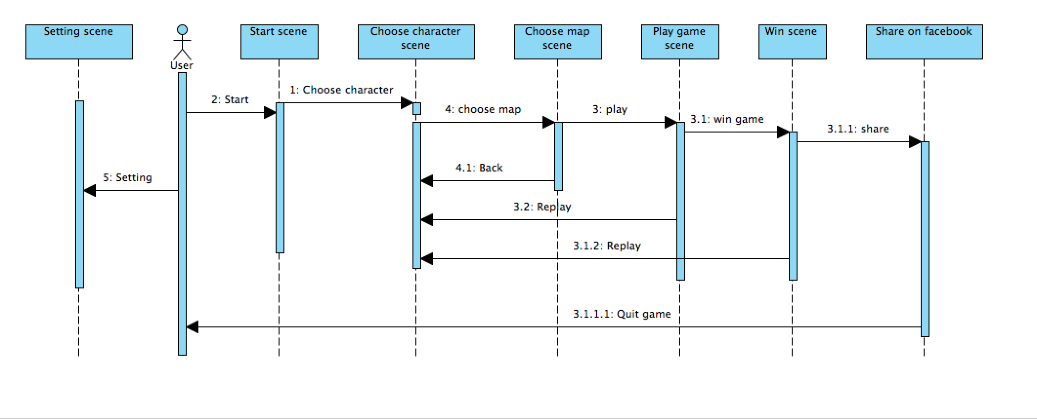
SEQUENCE DIAGRAM

Slide 29
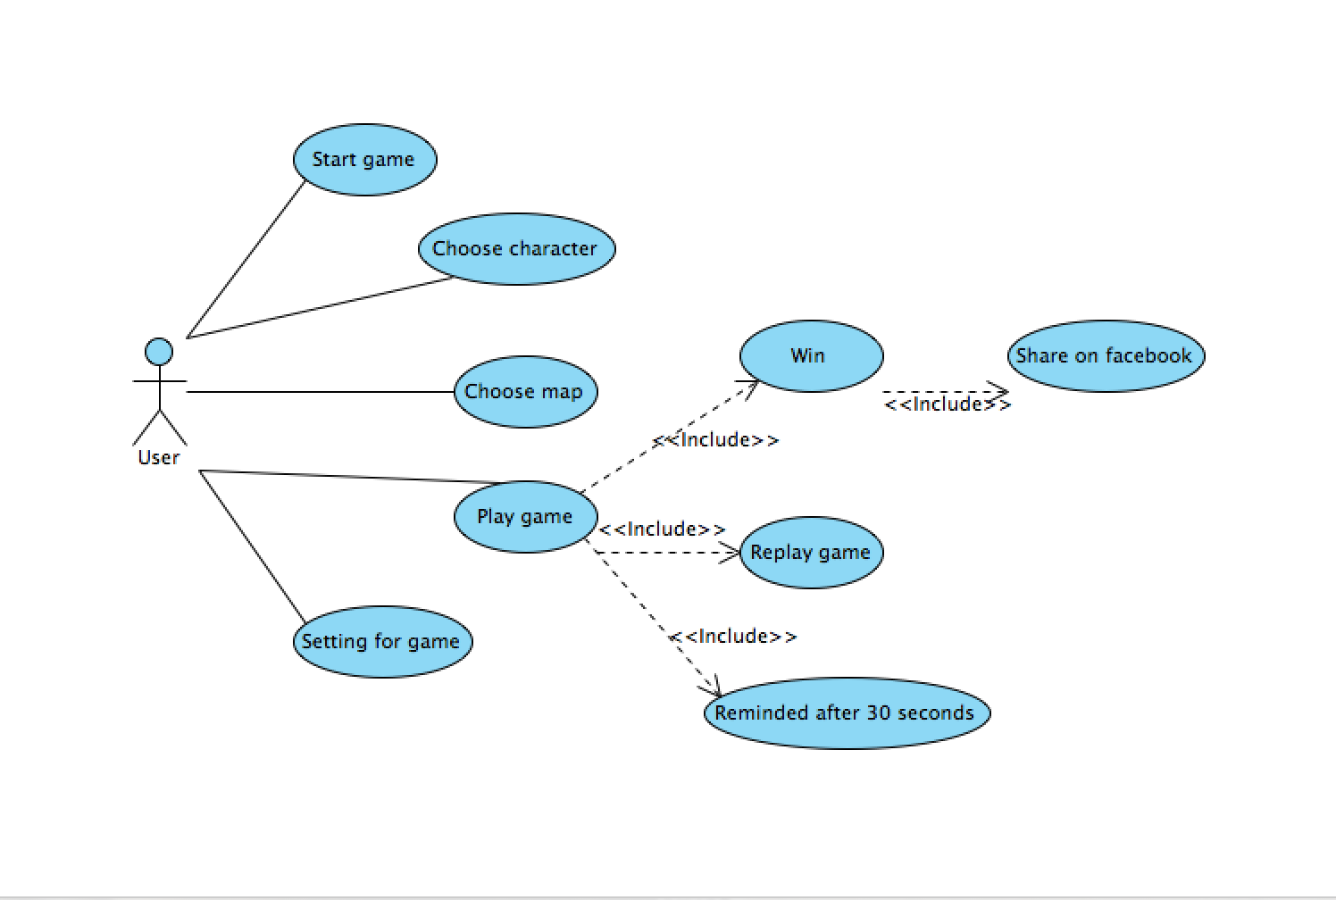
USER CASE DIAGRAM

Slide 30
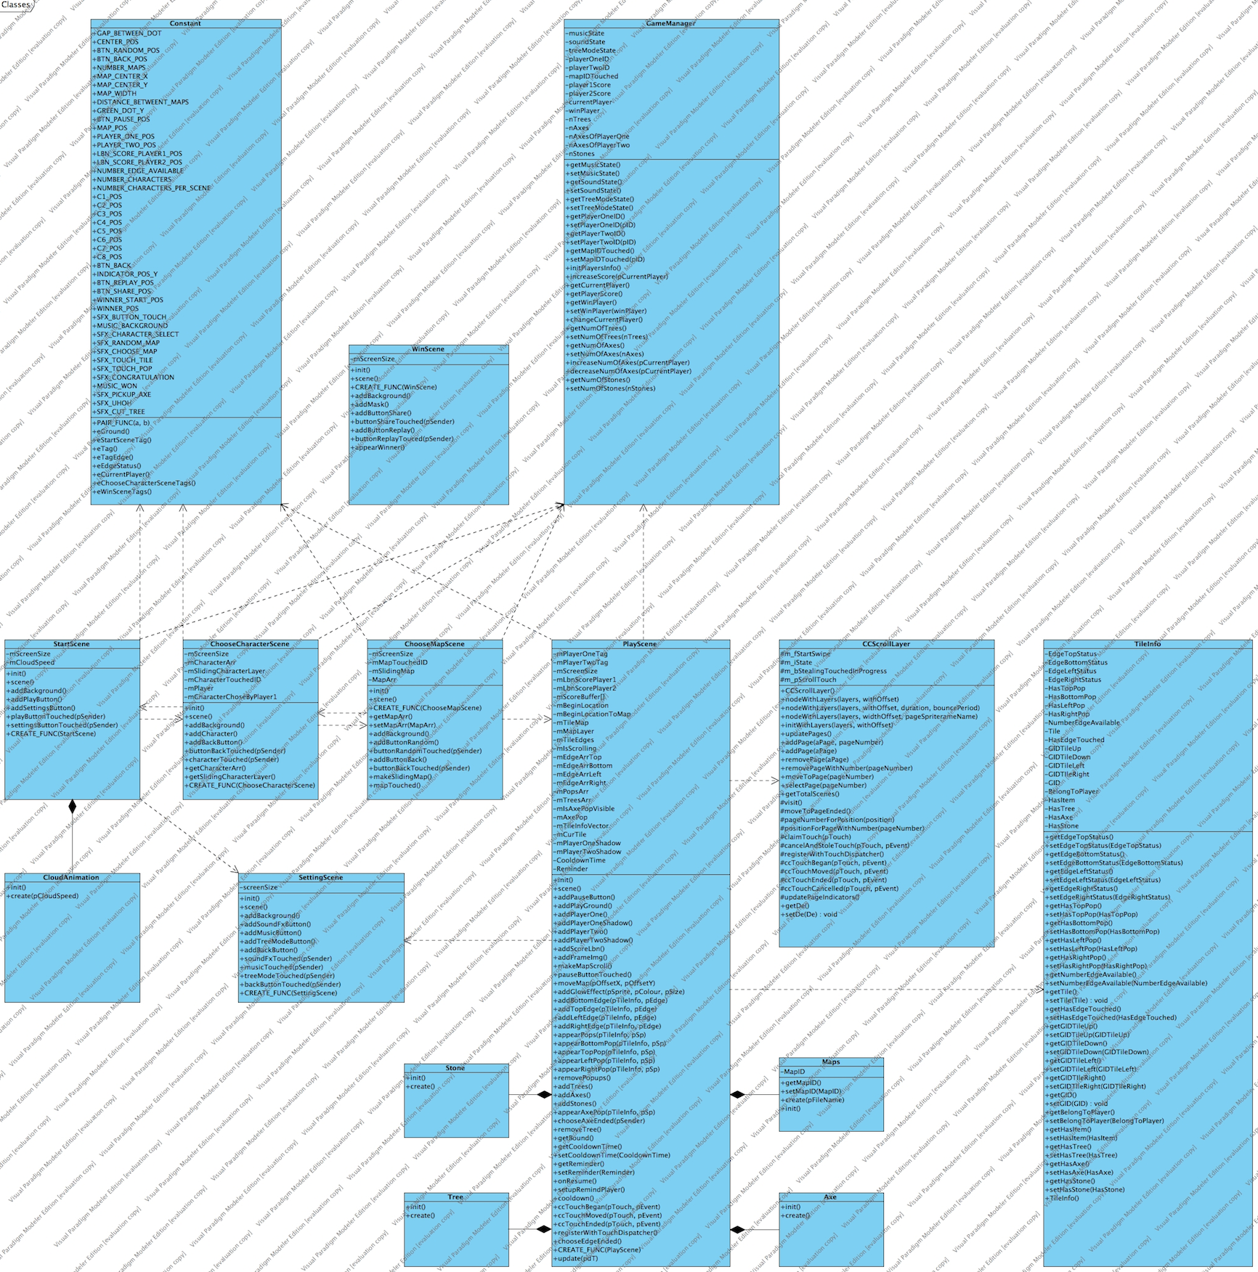
CLASS DIAGRAM

Slide 31
RELEASE
V0.1

Slide 32
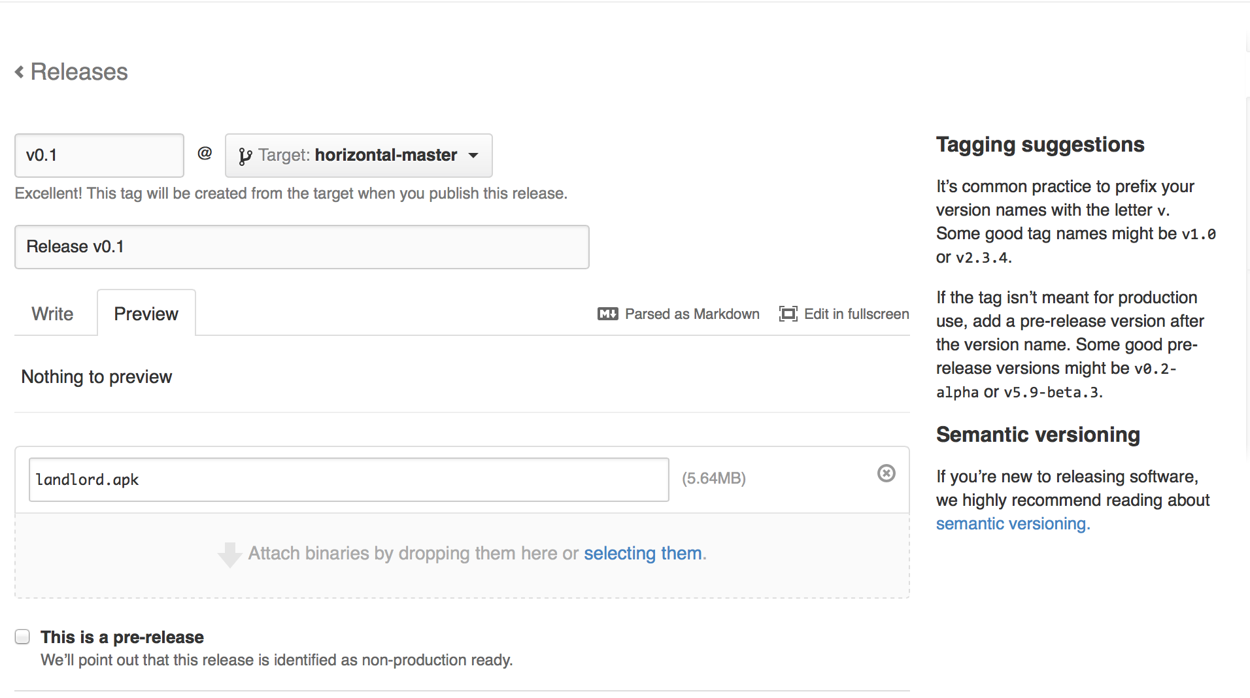
v0.1

Slide 33
THANK YOU FOR YOUR LISTENING!

